Slide 1
COP3502C PROGRAMMING FUNDAMENTALS 1
Recursion / Project 4

Slide 2
AGENDA
Attendance
Recursion
Q&A Session

Slide 3
Recursion

Slide 4
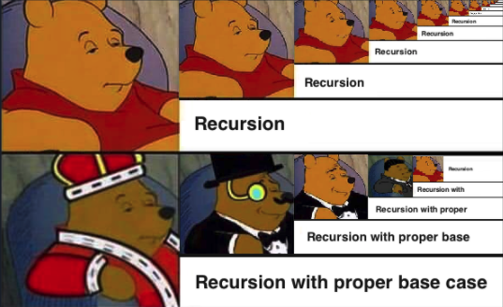
What is recursion
A recursive algorithm is an algorithm that refers to itself as part of the solution.
Components:
It has one or more base cases
It has one or more recurrence relations (computations where it calls itself)

Slide 5
Find Factorial of A Number
The factorial of a non negative number n is given by: n! = 1 * 2 * 3 * 4 * … * n
Examples
Factorial(5)= 5 * 4 * 3 * 2 * 1 = 120
Factorial(3)= 3 * 2 * 1 = 6
Base case: n=0 -> Factorial(0)=1
Recurrence relation: Factorial(n) = n * Factorial(n-1)
def factorial(n):
if n == 0:
return 1
return n * factorial(n - 1)

Slide 6
Factorial Example
Example: Factorial(4)
def factorial(n):
if n == 0:
return 1
return n * factorial(n - 1)
Stack
Factorial()
n = 0
1
Factorial()
n = 1
1 * 0!
Factorial()
n = 2
2 * 1!
Factorial()
n = 3
3 * 2!
Factorial()
n = 4
4 * 3!

Slide 7
Fibonacci Number
The Fibonacci numbers, denoted as F(n), forms the sequence
0, 1, 1, 2, 3, 5, 8, 13, 21, ….
The nth Fibonacci number F(n) is given by:
F(0) = 0 F(1) = 1
F(n) = F(n-2) + F(n-1)

Slide 8
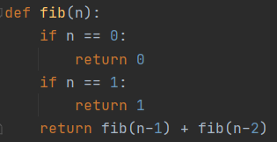
Write a function fib(n) that takes a non-negative integer n and returns the nth Fibonacci number F(n).
The first and second number of the sequence is 1.
To generate the next number, we sum the previous two numbers.

Slide 9
3
4
2
1
3
2
1
1
1
0
2
1
1
0
1
0
1
0
0 1 1 2 3

Slide 10
Q&A for Project 4

